Slide 1


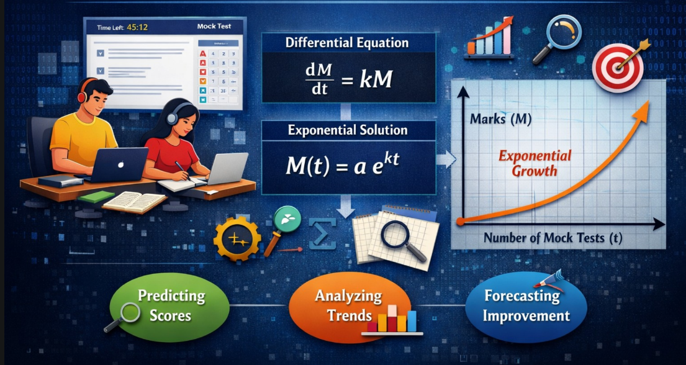
SCHOOL OF ENGINEERING
Project Presentation
Course : Calculus and Differential Equations
Term – 2
Title :MODELING MOCK TEST GROWTH USING DIFFERENTIAL EQUATIONS TO PREDICT STUDENT PERFORMANCE
Presented by :
Learning Group-1
A.Poojitha(251U1R2058)
K.Sree Rakshitha(251U1R2065)
Course instructor :
Mr.P.Kishore Reddy

Slide 2
ABSTRACT
This project studies how Differential Equations can predict student improvement in mock tests.
Students improve with practice.
Improvement follows a mathematical pattern.
Exponential growth model is used.
Project connects mathematics with real academic performance.

Slide 3
SLIDE CONTENTS
Introduction
Problem Statement
Objectives
Literature Survey
Tools and Technologies Used
Data Collection
Performance Data Table
Mathematical Model
Why Exponential Growth?
Mock Test Web Application
Instructions Page
Test Interface
Graphical Representation
Limitations
Future Scope
Conclusion

Slide 4
INTRODUCTION
Competitive exams require continuous practice
Mock tests help students improve gradually
Marks change over time with practice
Differential equations model changing quantities
Used to predict student performance growth

Slide 5
PROBLEM STATEMENT
Can student performance be predicted using differential equations?
Questions addressed:
• How does improvement depend on current marks?
• Can future marks be predicted?
• Is learning linear or exponential?

Slide 6
OBJECTIVES
Apply differential equations to education
Develop exponential growth model
Analyze mock test performance
Visualize results using graphs
Study limitations of model

Slide 7
LITERATURE SURVEY
AUTHORS & YEAR | TITLE | PURPOSE | OBJECTIVE | FUTURE SCOPE
Shaobo Huang & Ning Fang (2013) | Predicting Student Academic Performance Using Mathematical Models | To compare different mathematical and machine learning models for predicting student | To analyze GPA, midterm scores and previous grades to predict final performance. | Can be expanded using AI-based prediction systems and large educational datasets.
Patrick Kago (2024) | Mock Exams as Predictor of Final Examination Performance | To study relationship between mock exam scores and final exam results | To determine if mock tests can identify weak students early | Can be integrated into school systems for early warning and performance tracking.
Jaleh Rezaei & Nasim Asghary (2024) | Teaching Differential Equations using Mathematical Modelling | To study the impact of modelling-based teaching. | To improve problem-solving skills and mathematical understanding. | Can be applied in engineering and real-world educational modelling systems.

Slide 8
LITERATURE SURVEY
AUTHORS & YEAR | TITLE | PURPOSE | OBJECTIVE | FUTURE SCOPE
ResearchGaTe Study (2020) | Mathematical Modeling and Forecasting of Student Performance in Online Courses | To predict performance using online learning data. | To use student activity and engagement data for forecasting academic outcomes. | Can be extended to AI-driven educational analytics and smart learning platforms.
GeeksforGeeks Article | Applications of Differential Equations | To explain real-life applications of differential equations. | To show how changing quantities can be modeled mathematically. | Can be applied in academic performance prediction and learning analytics.

Slide 9
TOOLS AND TECHNOLOGIES USED
• HTML – Web page structure
• CSS – Styling
• JavaScript – Functionality
• Chart.js – Graph plotting
Advantages
• Lightweight & responsive
• Easy deployment
• Real exam-like environment

Slide 10
DATA COLLECTION
• Performance recorded for 10 mock tests
• Independent variable → Test number (t)
• Dependent variable → Marks (M)
• Marks increase continuously with practice

Slide 11
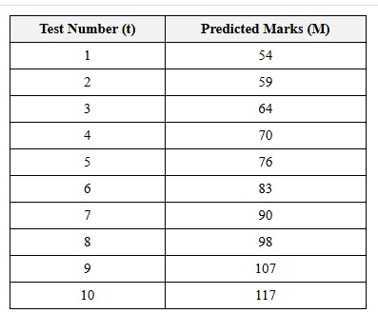
PERFORMANCE DATA TABLE

Slide 12
MATHEMATICAL MODEL
Assumption:
Rate of improvement ∝ Current performance
Differential Equation:
dM/dt = kM
Solution:
M(t) = a e^(kt)
Where:
• M(t) → Marks
• k → Growth rate
• t → Test number

Slide 13
WHY EXPONENTIAL GROWTH?
• Practice increases confidence
• Mistakes reduce with time
• Learning speed increases gradually
• Growth becomes faster over time

Slide 14
MOCK TEST WEB APPLICATION
Features:
• 60-minute timer
• 100 MCQ questions
• Question palette navigation
• Save & Next option
• Clear response option

Slide 15
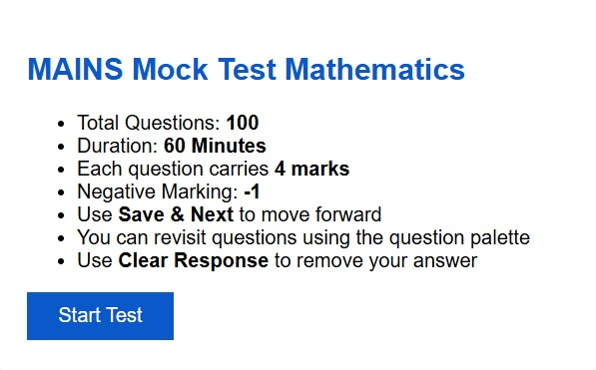
INSTRUCTIONS PAGE

Slide 16
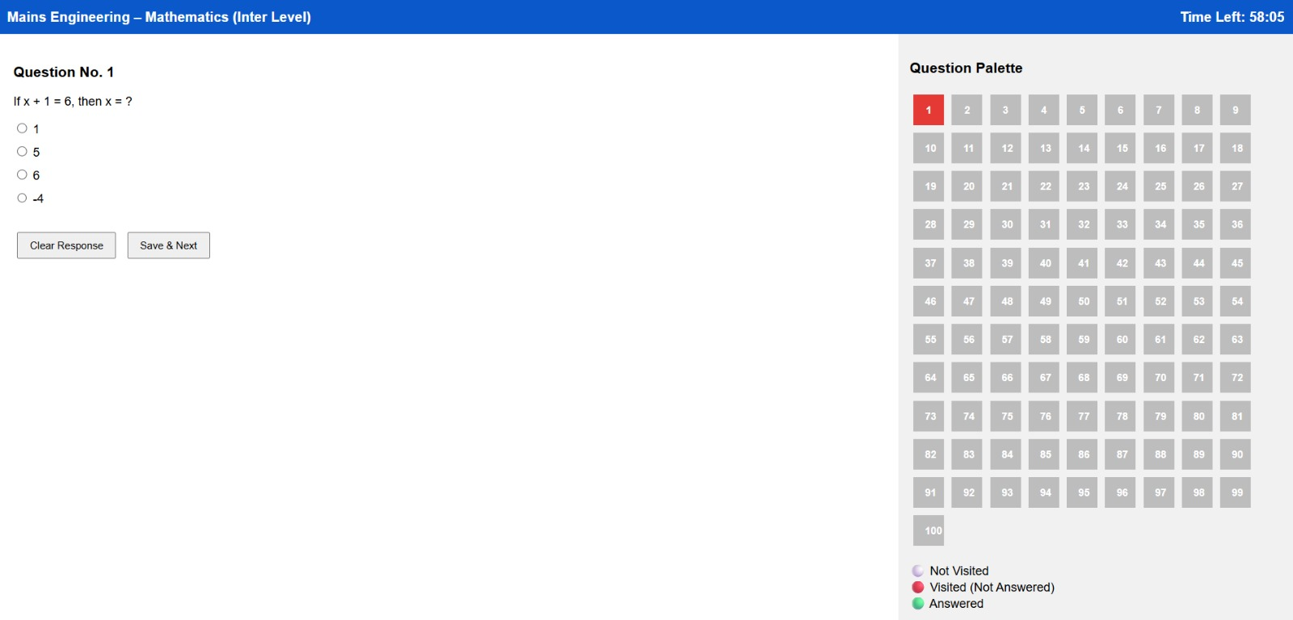
TEST INTERFACE

Slide 17
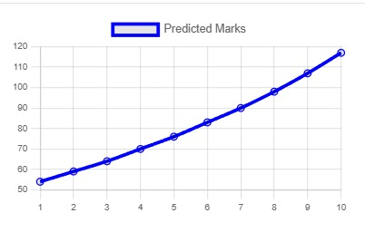
GRAPHICAL REPRESENTATION
• Graph shows upward curve
• Improvement accelerates with time
• Confirms exponential growth

Slide 18
LIMITATIONS
• Small dataset (10 tests)
• Real performance may vary
• Maximum marks limit ignored
• Logistic model needed in future

Slide 19
FUTURE SCOPE
• Use real student data
• Apply Machine Learning models
• Add login & database
• Mobile app version
• Personalized study suggestions

Slide 20
CONCLUSION
• Differential equations predict performance growth
• Exponential learning curve fits early learning
• Combines maths with real-life application
• Helps students track improvement

Slide 21
THANK YOU!

